Slide 1

"Portfolio Risk Management Dashboard
”SAFEGUARDING INVESTMENTS IN AN UNCERTAIN MARKET”
IS THE PORTFOLIO DOING WELL?

Slide 2

Introduction
In the dynamic landscape of financial markets, effective risk management is paramount to achieving sustainable investment success. As investors or portfolio managers navigate through diverse asset classes, market conditions, and economic uncertainties, the ability to monitor and manage portfolio risk becomes a strategic imperative. To empower investors with comprehensive insights and actionable information, we present our Portfolio Risk Management Dashboard

Slide 3

Dashboard Overview
"Holistic View of Your Investment Portfolio"
As you embark on optimizing your portfolio risk management, our dashboard stands as a reliable ally, offering transparency, actionable insights, and a comprehensive overview of your investment risk landscape.
Welcome to a new era of empowered decision-making in the pursuit of your financial objectives.

Slide 4

Key Features
"Empowering Investors with Comprehensive Insights"
Risk Metrics Overview
Access key risk metrics: standard deviation, beta, and performance indicators.
Diversification Analysis
Visualize portfolio diversification across asset classes, sectors, and regions.
Scenario Analysis
Evaluate the impact of different market scenarios on the portfolio.

Slide 5

Conti….
Dynamic Asset Allocation
Monitor real-time asset allocation, receive alerts for adjustments.
Performance Attribution
Understand drivers of portfolio performance through detailed attribution analysis.
Customizable Risk Alerts
Set personalized risk thresholds and receive real-time alerts.

Slide 6

Dashboard Interface
User-Friendly Interface:
Enjoy a user-friendly interface designed for accessibility and ease of use.
Navigate seamlessly through complex risk data.
Real-Time Updates:
Benefit from real-time data updates, ensuring that you have the latest information at your fingertips.
Make timely and well-informed decisions.
Customization for Your Needs:
Tailor the dashboard to your specific preferences and requirements.
Whether focused on individual stock holdings or diverse investment portfolios, our platform adapts to your unique needs.

Slide 7

Data Sources
"Reliable Data for Informed Decisions"
Data sourced primarily from Google Finance.
Aggregated from various financial data providers for real-time stock quotes, financial news, and information.

Slide 8

Visualization Tool: Power BI
"Transforming Data into Actionable Insights"
Power BI's features: data connectivity, modeling, interactive dashboards, and a wide range of visualizations.
Seamless integration with other Microsoft products for enhanced collaboration.

Slide 9
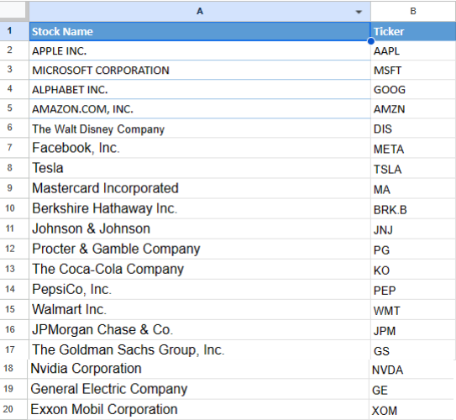
Stocks in the Portfolio
"US Stocks Driving Your Investment"

Slide 10
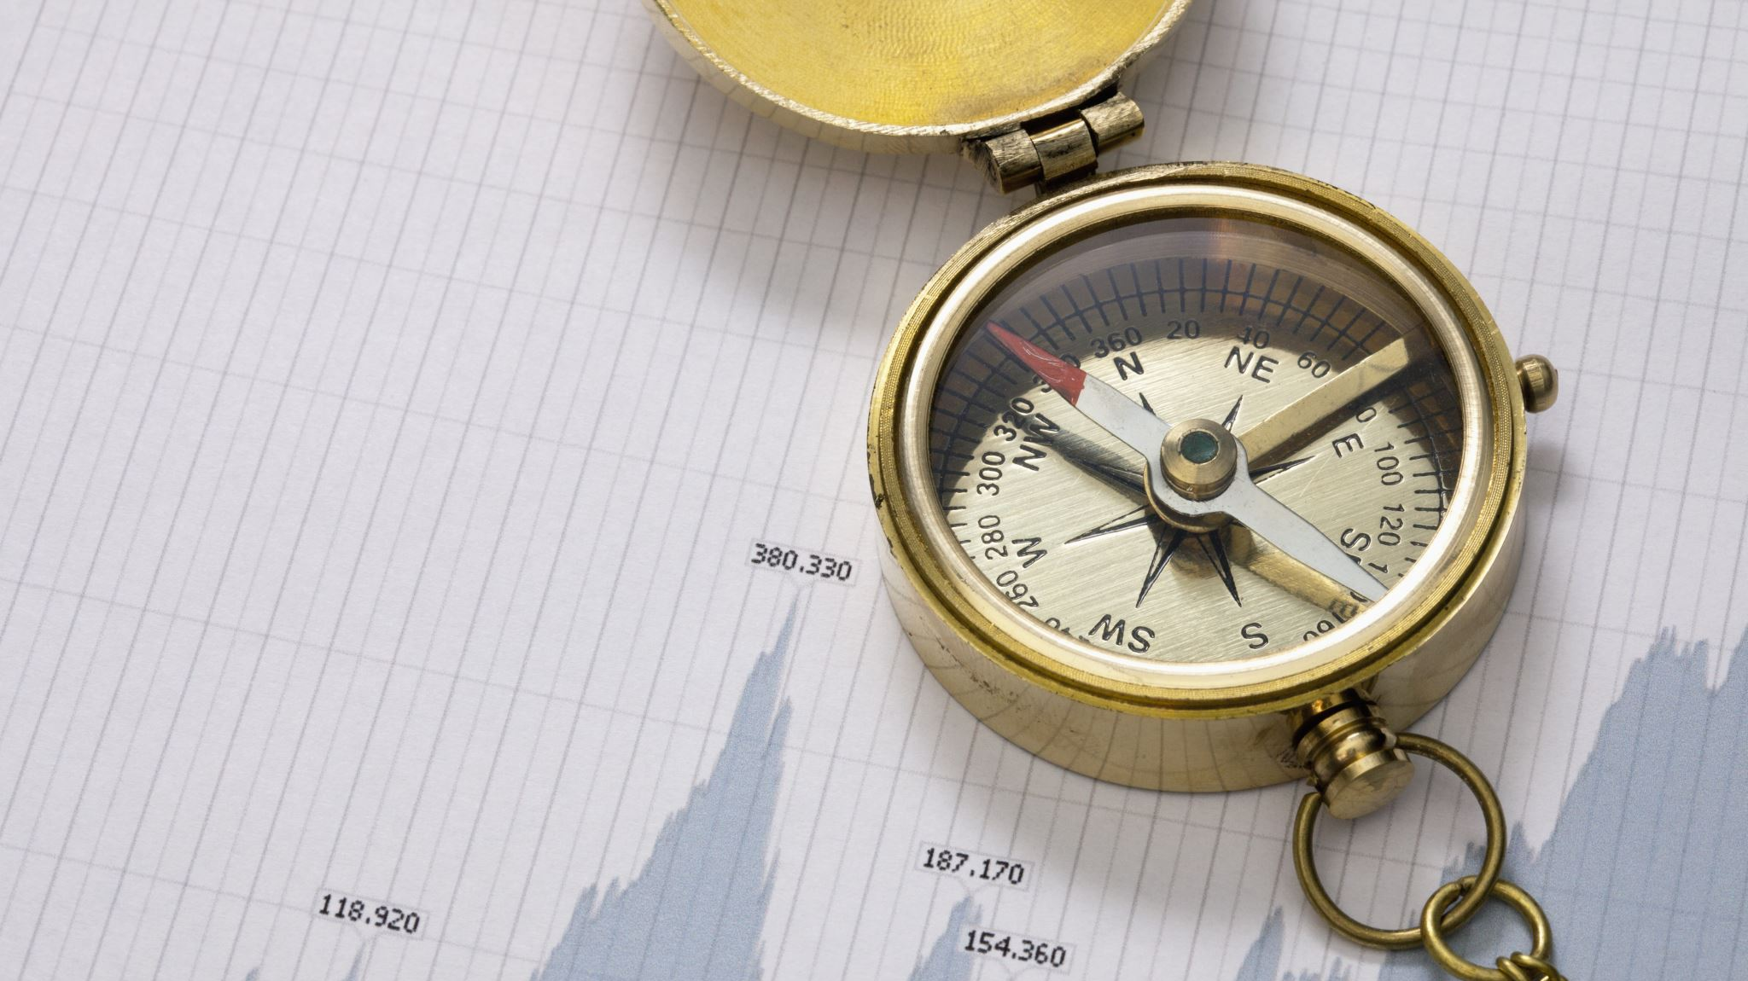
Insights from Visualization
"Decoding Risk Metrics"
Fig. 1.1: Historical Volatility
Interpretation of high historical volatility indicating potential price fluctuations.
Fig. 1.2: Asset Contribution and Local Excess Risk Breakdown
Understanding high Asset Contribution and Local Excess Risk during specific time periods.
Fig. 2.1 and 2.2: Asset Contribution to Risk and Asset Weight
Relationship between asset contribution to risk and asset weight, emphasizing risk concentration and diversification.
Fig. 2.4: Risk Metrics
Interpreting positive and negative risk metrics for each stock.

Slide 11
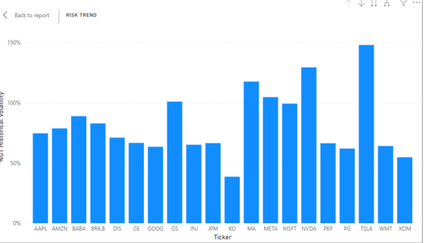
Historical Volatility
In the Fig. we the stocks on average has a more 50% volatility except for the stock KO which is below 50%,

Slide 12
Conti….
A high volatility means:
Greater Price Fluctuations
Increased Risk
Market Uncertainty
Options Pricing Impact
Short-Term Trading Opportunities:.
Potential for Rapid Losses or Gains
Consideration in Risk Management
It's important to note that historical volatility is based on past price movements and does not predict future volatility with certainty. Market conditions can change, and historical volatility may not accurately reflect future price behavior.

Slide 13
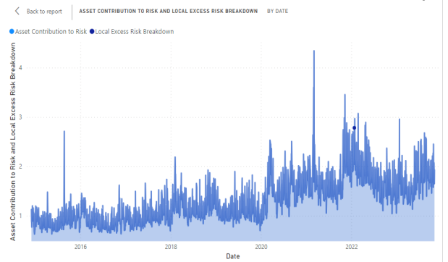
Contribution and Local Excess Risk Breakdown
In the Fig. we see the breakdown of asset contribution and excess risk, we can see the portfolio is at its highest level in 2021 towards 2022 and it has been fluctuating since then.

Slide 14
Conti….
A high Asset Contribution and Local Excess Risk Breakdown can highlight the strengths and vulnerabilities of a portfolio
Potential Trade-offs
Active Management Considerations
Strategic Decision-Making.
Market and Economic Insights

Slide 15
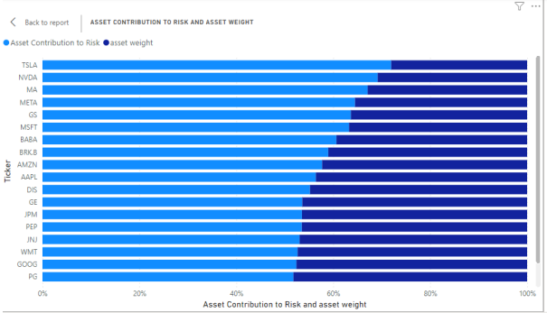
Asset Contribution to Risk and Asset Weight
In this Fig its shows the asset contribution to risk and the asset weight of the stock in a portfolio and we can see TSLA has the highest contribution to risk and has the lowest asset weight, before we understand this visualization, and we see the contribution risk is more than asset weight in the visualization.

Slide 16
Conti…
Relationship Between Asset Contribution to Risk and Asset Weight:
1. Risk Concentration
2. Diversification Effect
3. Risk-Return Trade-off
4. Strategic Decision-Making

Slide 17
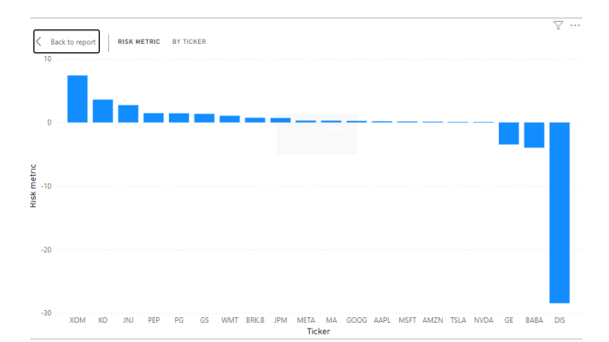
Risk Metric
Risk metric, the we see above the we have both a positive and negative metrices on some of the tickers or stocks and a positive value indicates the magnitude or level of risk and a lower value is desirable, a negative result could indicate a reduction in risk, so with this the portfolio manager can see stocks that positively risker like show in the Visualisation and the ones that are negative and not risk at all.

Slide 18
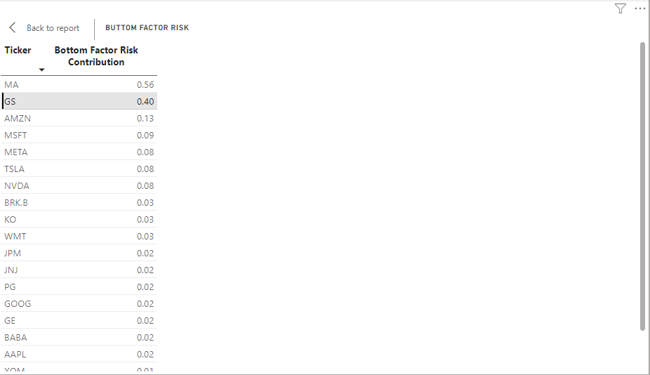
BOTTOM FACTOR RISK CONTRIBUTION
The bottom factor risk or the factor risk contribution, in the above we can see below in stock MA has the highest factor risks contribution of 0.56 which means If a specific factor has a high-risk contribution to the overall portfolio risk, it means that the fluctuations or movements in that factor have a significant impact on the portfolio's volatility.

Slide 19
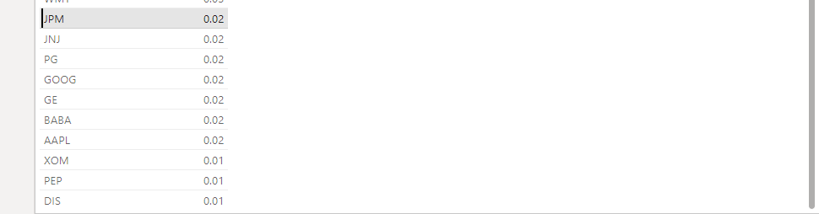
Conti….
In the other part of the bottom factor contribution, we could see the stocks are from 0.2 to 0.1 which is the lowest

Slide 20
Conti…
n summary, the bottom factor contrition is only significant in the first stock which is MA, as the benchmark is 0.5 above is significant.

Slide 21

Sub-Insights
"Digging Deeper into Portfolio Performance"
Fig. 3.1: Number of Stocks and Investments
Overview of the number of stocks and investments in the portfolio.
Fig. 3.2: Portfolio Value and Cost
Monitoring profit and loss, highlighting the portfolio's positive trajectory.
Fig. 3.3: Profit and Loss of Each Stock
Fig. 3.4: Stock Prices Increase
Visualizing the increase in stock prices, emphasizing positive trends.
Fig. 3.5: Daily Performance
Understanding daily stock performance, with a focus on market trends and the impact of the COVID-19 period.

Slide 22
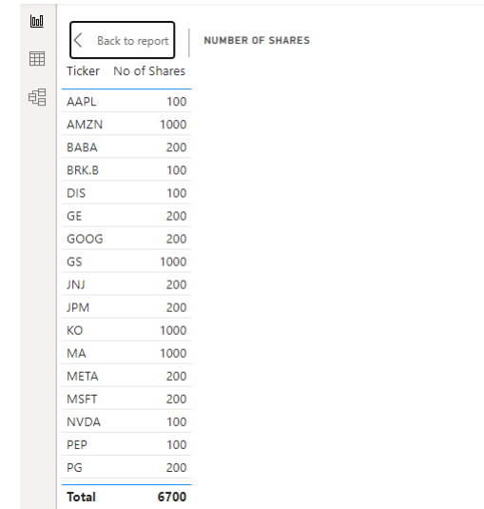
Number of Stocks and Investments
This shows that in this portfolio there is 20 different stocks and the number of stocks in which each stock is invested, and we can see there is an overall of 6700 stocks invested, with a minimum of 100 and maximum of 1000 for a stock company

Slide 23
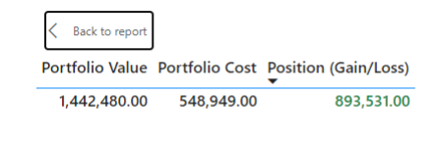
Portfolio Value and Cost
In the fig below we can see the portfolio value and the cost and which shows that the portfolio is running at a profit as it shows in the green and most portfolio managers make sure that the portfolio always runs at a profit at any given time.

Slide 24
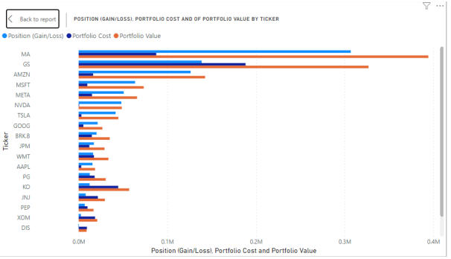
Profit and Loss of Each Stock
In the above illustration, we can see the profit and loss of each stock , this visualization actually gives the portfolio manager more insights on how each stock is performing on a given period of time.

Slide 25
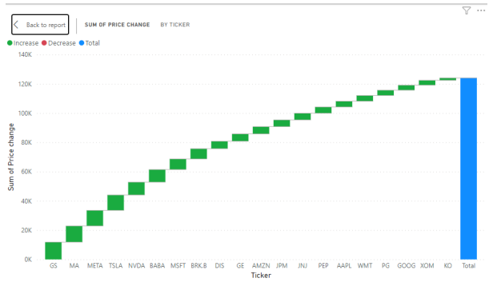
Stock Prices Increase
In the illustration below we see there is constant increase in the price of the stocks even though, ranging from the stock GS being the highest and KO being the lowest an increase in price of stock

Slide 26
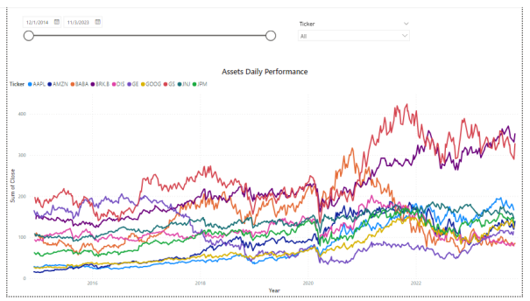
Daily Performance
Daily performance of the stocks, this illustrates, the daily performance of the stocks from 2015 to date, and this visualization the portfolio manager can choose the date and the stock, he or she wants to monitor using those buttons shows above

Slide 27
Is the Portfolio Doing Well?
"Achieving Financial Success: Portfolio Doing Well"
Key Metrics:
Positive Returns:
The portfolio has consistently delivered positive returns over the assessed period.
Risk Mitigation Success:
The risk mitigation strategies implemented have proven effective.
Volatility has been managed, ensuring stability in the portfolio.

Slide 28
Conti….
Strategic Decision-Making:
Strategic decisions made during market uncertainties have yielded positive results.
Adaptive responses to economic conditions showcase portfolio manager expertise.
Consistent Profitable Stocks:
The majority of stocks in the portfolio are consistently running at a profit.
Reflects the sound selection and management of individual stocks.
With all this key metrics we can say the portfolio is doing well.

Slide 29
Conclusion
"Empowered Decision-Making for Financial Success"
The Portfolio Risk Management Dashboard stands as a dynamic and indispensable tool in the arsenal of investors seeking to safeguard their investments in an uncertain market. By combining analytics, risk metrics, and strategic insights, the dashboard empowers users to navigate market fluctuations, optimize portfolio performance, and achieve long-term financial success. Regular updates and enhancements to the dashboard ensure its relevance and effectiveness in addressing the evolving challenges of the investment landscape.

Slide 30

References
1. https://www.google.com/url?sa=t&rct=j&q=&esrc=s&source=w eb&cd=&cad=rja&uact=8&ved=2ahUKEwiHkpyMnLWDAxUKygI HHXSCC14QFnoECB4QAQ&url=https%3A%2F%2Fsupport.googl e.com%2Fdocs%2Fanswer%2F3093281%3Fhl%3Dde&usg=AOv Vaw0QbdOgTplQ0Sb5rGXvfzpg&opi=89978449
2. https://www.google.com/url?sa=t&rct=j&q=&esrc=s&source=w eb&cd=&cad=rja&uact=8&ved=2ahUKEwj77uOwnLWDAxUv3AI HHdqdD7cQFnoECBYQAw&url=https%3A%2F%2Fwww.microsof t.com%2Fde-de%2Fpower-platform%2Fproducts%2Fpowerbi%23%3A~%3Atext%3DWas%2520ist%2520Power%2520BI%2 53F%2Cein%252C%2520die%2520Sie%2520t%25C3%25A4glich %2520verwenden.&usg=AOvVaw0xb4WJfvHdg7VwF3nsMtxK& opi=89978449
3. https://www.google.com/url?sa=t&rct=j&q=&esrc=s&source=w eb&cd=&cad=rja&uact=8&ved=2ahUKEwiDgcbLnLWDAxUn7gIH HSN4CU8QFnoECCYQAQ&url=https%3A%2F%2Fwww.financestr ategists.com%2Fwealth-management%2Finvestmentrisk%2Fportfolio-riskmanagement%2F&usg=AOvVaw1deSS_CJAVgdqKa_WdW13g&

